Slide 2

PROJECT I
Microsoft Team Management App
Phan Thu Ha 20225571
Truong Thao Nguyen 20220067
Cyber Security 01 K67

Slide 3
Outline
1. Introduction
3. Results
4. Demo
2. Methods
5. Future Development

Slide 4

1. Introduction
Microsoft Team: leading platform for collaborative work
Managing MSTeam environment is complex for large organizations
In order to address this challenge:
Microsoft Team Management App

Slide 5
1. Introduction
Our app supports:
Ensuring Proper Permissions
Data Synchronization with Airtable
Channel Creation
Bulk Member Addition from CSV Files
Adding Members to Private Channels

Slide 6





2. Methods
Our app utilizes:

Slide 7
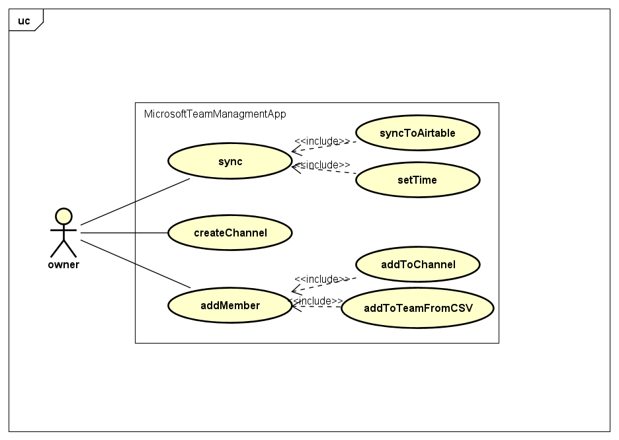
2. Methods
Usecase Diagram

Slide 8
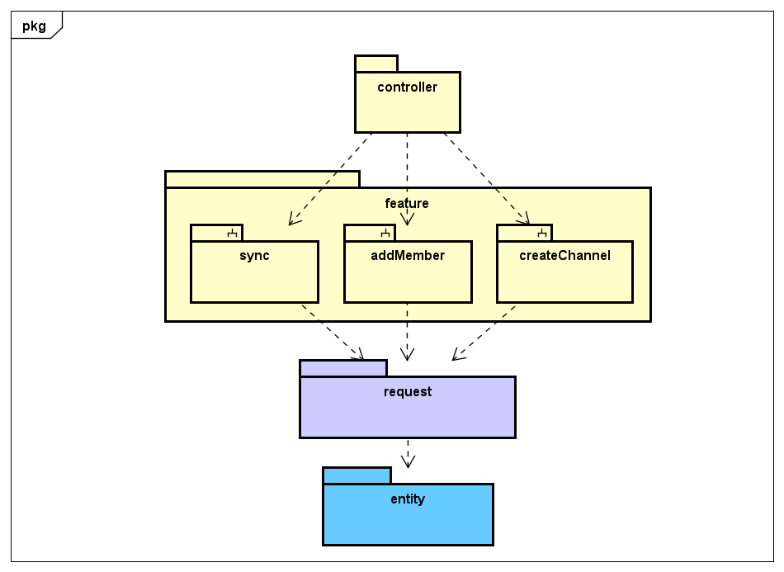
2. Methods
Package Dependency

Slide 9
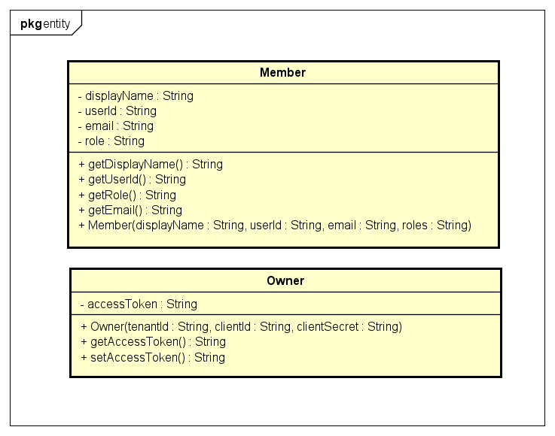
2. Methods
Class Diagrams
Entity Classes

Slide 10
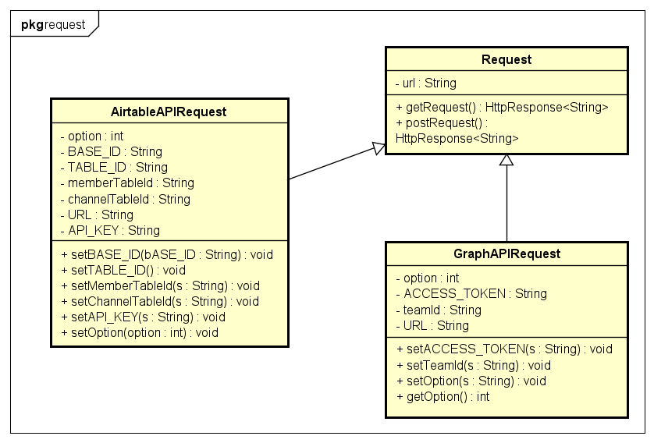
2. Methods
Class Diagrams
Request Classes

Slide 11
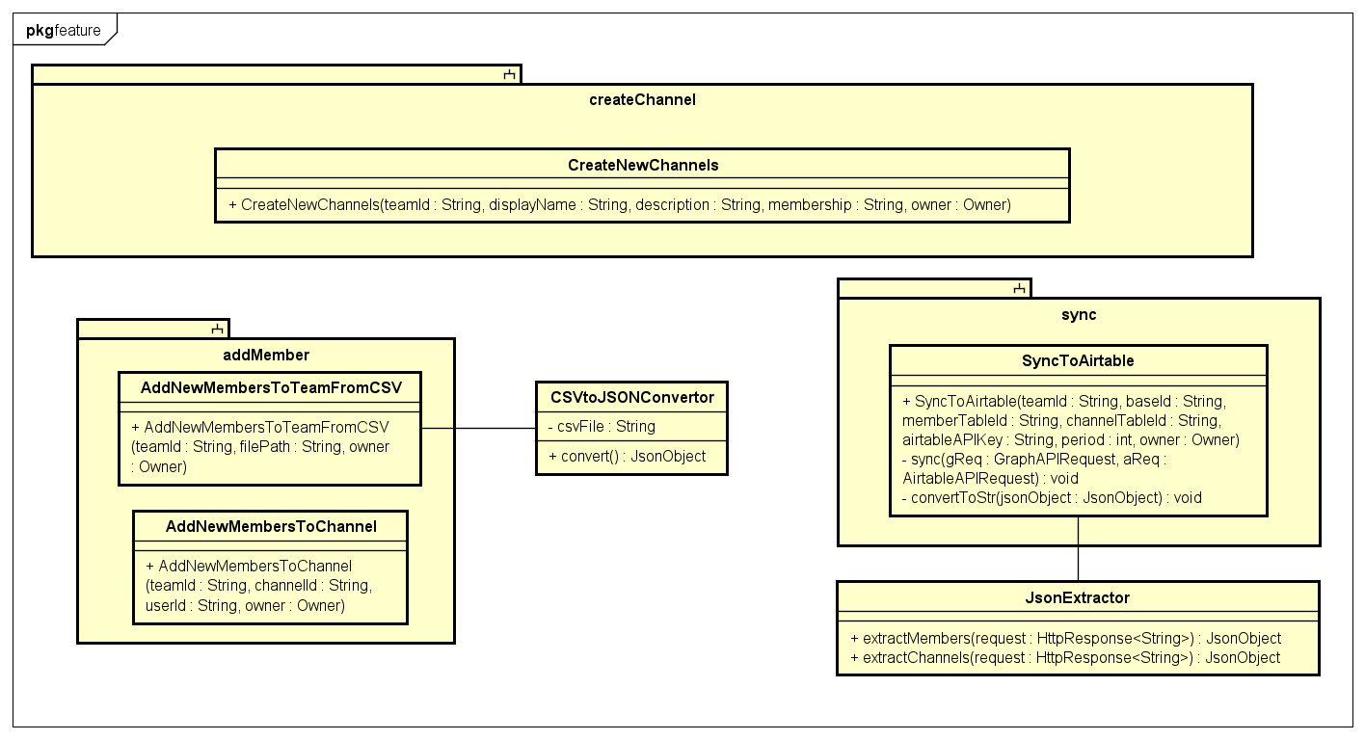
2. Methods
Class Diagrams: Feature Classes

Slide 12
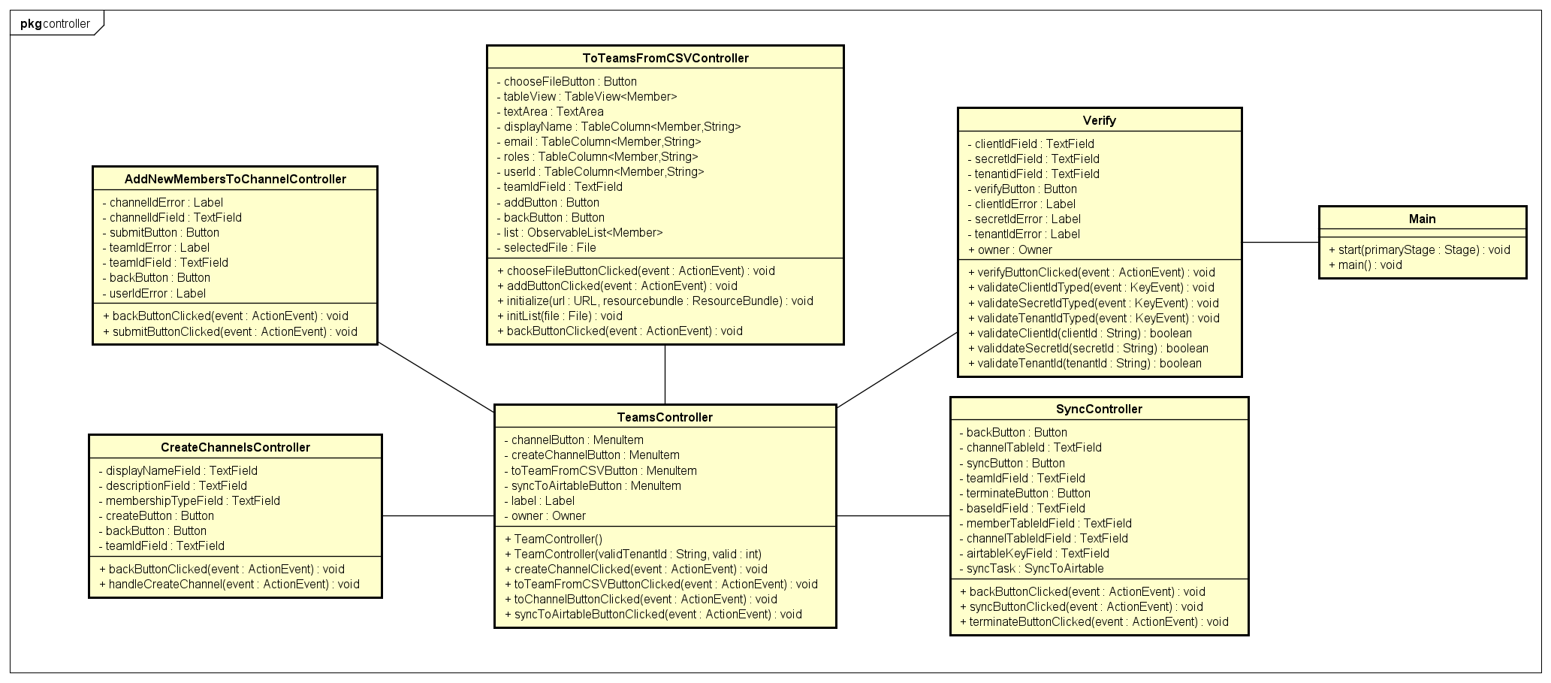
2. Methods
Class Diagrams: Controller Classes

Slide 13
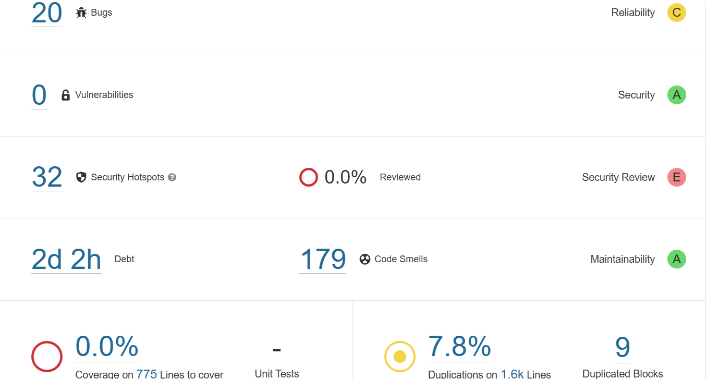
3. Results
First tests

Slide 14

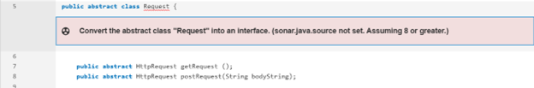
3. Results
Some bugs and code smells [SOLVED]
Casting in multiplication operation
Abstract class without direct or inherited field

Slide 15


3. Results
Some bugs and code smells [SOLVED]
Commented-out lines
Declaring a variable only to immediately return

Slide 16
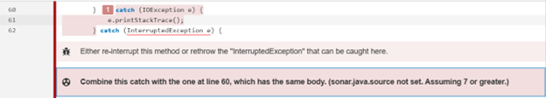

3. Results
Some bugs and code smells [SOLVED]
Multiple catch blocks with same code
Nested try block

Slide 17
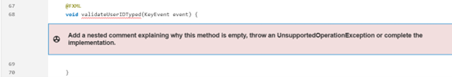
3. Results
Some bugs and code smells [SOLVED]
Unintentional omission
Unused local variable

Slide 18
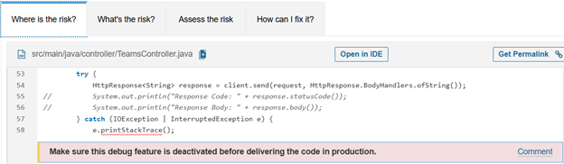
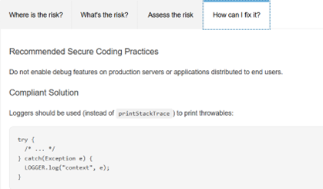
3. Results
Some bugs and code smells [UNSOLVED]
Logger

Slide 19
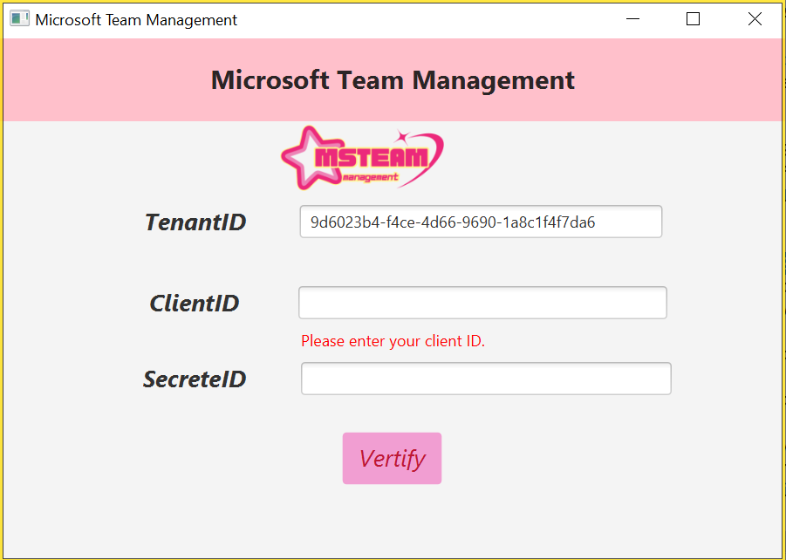
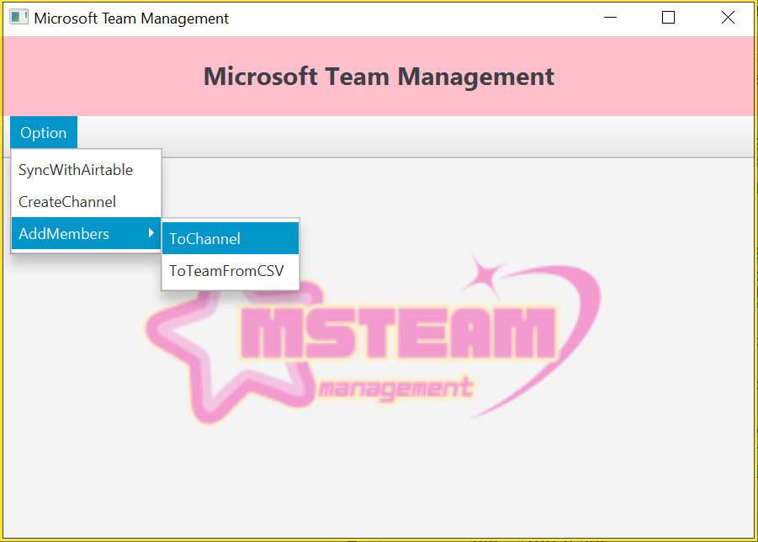
4. Demo
4.1 Verify & homepage

Slide 20
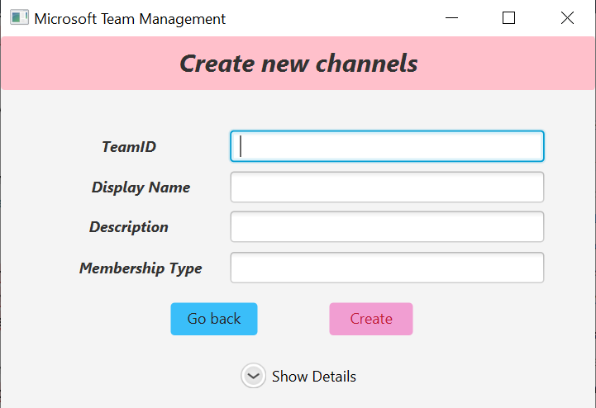
4. Results
4.2 Create New Channels

Slide 21
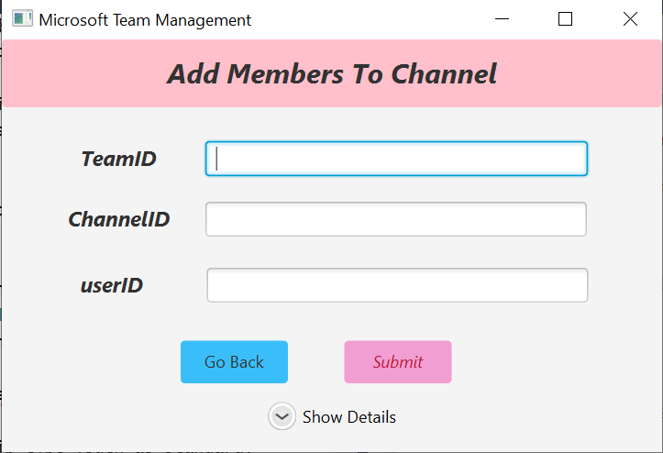
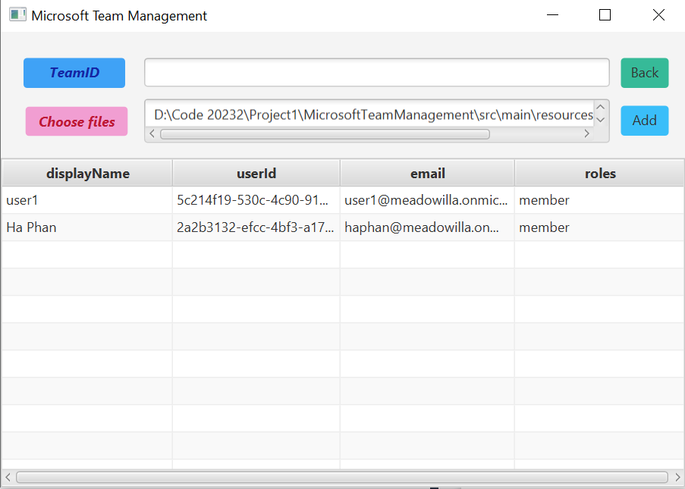
4. Results
4.3 Add New Members

Slide 22
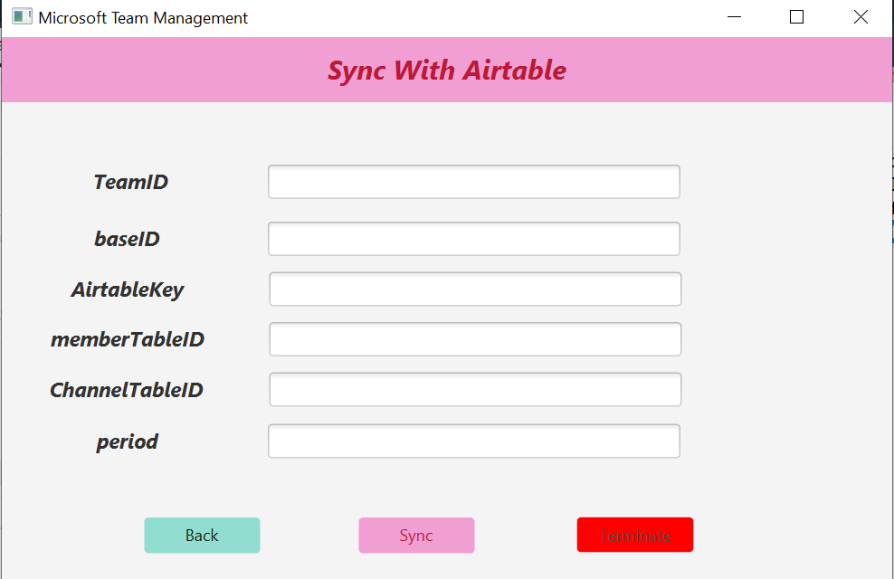
4. Results
4.4. Sync To Airtable

Slide 23
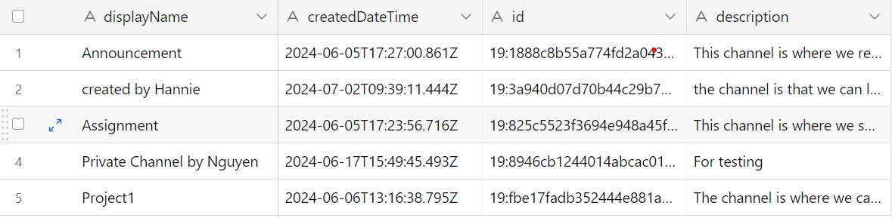
5.Future Development
More user-friendly GUI
User guideline
Smarter Syncing

Slide 24
Reference
[1] Microsoft Teams Collaboration https://www.microsoft.com/insidetrack/blog/microsoft-teams-increasescollaboration-in-the-modern-workplace-at-microsoft/ [2] Microsoft Graph API https://learn.microsoft.com/en-us/graph/api/resources/teams-api-overview?view=graph-rest-1.0 [3] Create a new channel https://learn.microsoft.com/en-us/graph/api/channel-post?view=graph-rest-1.0&tabs=http [4] Add member to channel https://learn.microsoft.com/en-us/graph/api/channel-post-members?view=graph-rest-1.0&tabs=http [5] Add member to team https://learn.microsoft.com/en-us/graph/api/team-p ost-members?view=graph-rest-1.0&tabs=http [6] Lists members of team https://learn.microsoft.com/en-us/graph/api/team-list-members?view=graph-rest-1.0&tabs=http [7] Get access without a user https://learn.microsoft.com/en-us/graph/auth-v2-service?tabs=http [8] Wikipedia, Airtable https://en.wikipedia.org/wiki/Airtable [9] Wikipedia, Jenkins https://en.wikipedia.org/wiki/Jenkins_(software) [10] Wikipedia, SonarQube https://en.wikipedia.org/wiki/SonarQube [11] Delete multiple records https://airtable.com/developers/web/api/delete-multiple-records

Slide 25
Thank you
for listening!

